Slide 1


IOS 64Bit Application Transition
Fangpo, Xu
© Polycom, Inc. All rights reserved.

Slide 2
Agenda
Different Data Models
IOS Data Model
Code Transition
Example Code

Slide 3
Data Models
Type | LP32(2/4/4) | ILP32(4/4/4) | LLP64(4/4/8) | LP64(4/8/8) | ILP64(8/8/8)
CHAR | 8 | 8 | 8 | 8 | 8
SHORT | 16 | 16 | 16 | 16 | 16
INT | 16 | 32 | 32 | 32 | 64
LONG | 32 | 32 | 32 | 64 | 64
POINTER | 32 | 32 | 64 | 64 | 64
LONG LONG | 64 | 64 | 64 | 64 | 64

Slide 4
Data Models
Type | Operating System | INT | LONG
LP32 | Win3.1 / Apple Macintosh | 16 | 32
ILP32 | Most of today’s 32 bit-systems | 32 | 32
LLP64 | Windows 64 (From Win7/Vista) | 32 | 32
LP64 | Mac OS X / IOS64 / Unix / Linux | 32 | 64
ILP64 |  | 64 | 64

Slide 5
IOS 64BIT
IOS 64Bit Start from IOS7/A7 Processor
On a 64-bit device, iOS includes separate 32-bit and 64-bit versions of the system frameworks.
Xcode 5.0.1 and later
Combined binary support: iOS 5.1.1 or later

Slide 6
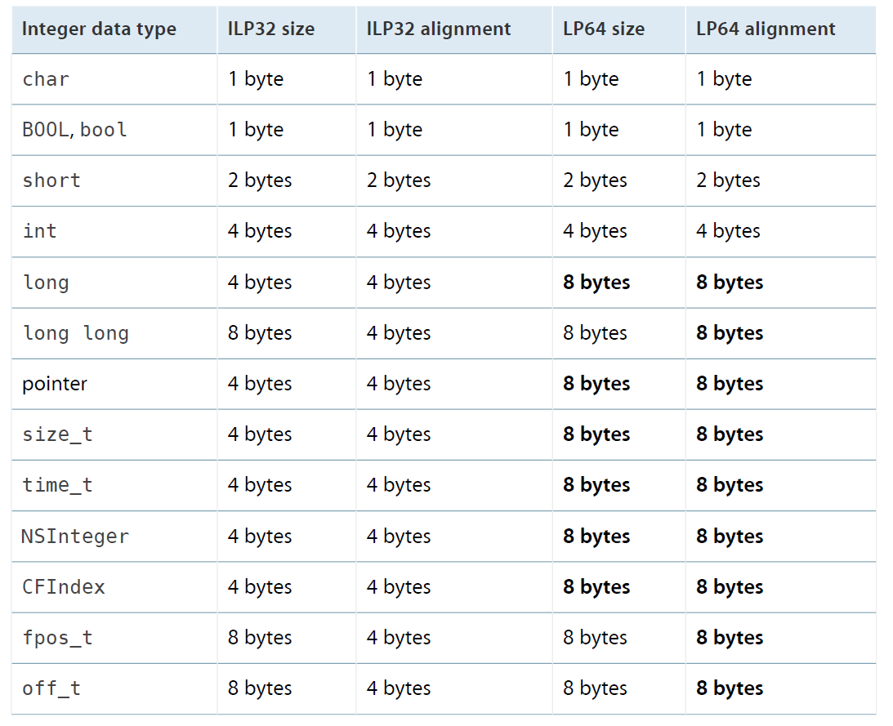
Size and alignment of integer data types in OS X and iOS

Slide 7
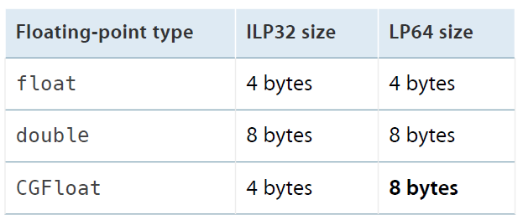
Size of floating-point data types in OS X and iOS

Slide 8
Project Transition
Xcode Project
  UI/CC/MP
  H323 Stack/Sip Stack/Utility Library
Makefile Project
  OSS library such as: openssl libcurl ldap, etc

Slide 9
Fat Library
Result Application can work for both iOS 32 and iOS 64.
Library has two sets of Symbols, example:
  00000e10 T _SSL_read
  000000000000134c T _SSL_read
lipo libssl-armv7.a libssl-arm64.a -create -output libssl.a

Slide 10
Code Transition
Data Truncate
Impact of Function Call Changes
assembly language code
System Library

Slide 11
Data Truncate
Long to Int
  size_t ssize_t
Pointer to Int
  Use long
Numeric Constants
  long a = 0xffffffff; long a = -1L;
  long a = 0x80000000; long a = 1L << ((sizeof(long) * 8) - 1);
Allocate memory using sizeof
Formatting String

Slide 12
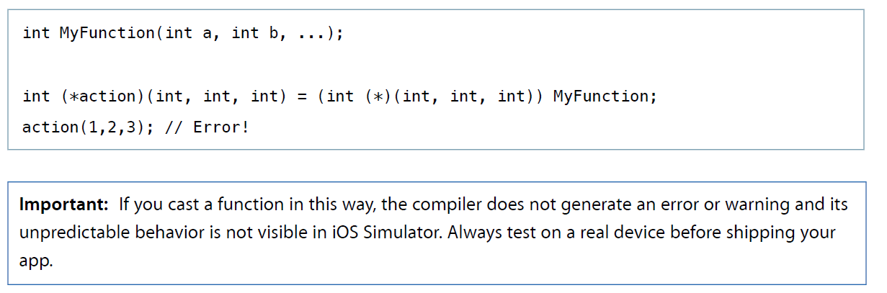
Impact of Function Call Changes
Casting between variadic and nonvariadic functions results in an error

Slide 13
Impact of Function Call Changes
Every function must have a prototype.

Slide 14
Position Independent
The 64-bit runtime environment supports only Position-Independent Executables (PIE)

Slide 15
Compile Option/ Marco
-arch x86_64
Armv7, arm64
__LP64__
  #ifdef __LP64__
  // 64-bit code
  #else
  // 32-bit code
  #endif

Slide 16
Example Problematic Code
int http_code = 0;
curl_easy_getinfo(curl, CURLINFO_RESPONSE_CODE, &http_code);
cmTransportAddress ta;
memset(&ta, 0, sizeof(&ta));
str += "s=Polycom IP Phone"CRLF;

Slide 17
Example Problematic Code
local const unsigned long FAR crc_table[TBLS][256] =
{
{
0x00000000UL, 0x77073096UL, 0xee0e612cUL, 0x990951baUL, 0x076dc419UL,
…

Slide 18
Example Problematic Code
uint32 srcRemain = srclen, dstRemain = destlen;
iconv_t cd;
cd = iconv_open("UTF-16LE", "UTF-8");
if (cd == (iconv_t)-1)
return 0;
if (iconv(cd, &src, &srcRemain, &dst, &dstRemain) == (size_t)-1)
return 0;

Slide 19
Other Issues
Duplicate Symbol
  HMAC() in SRTP
Ldap not work on MAC
  Sasl version

Slide 20
Reference
Why LP64 - http://www.unix.org/version2/whatsnew/lp64_wp.html

Slide 21
Q&A

